Slide 1
Evaluation Scheme
Evaluation Scheme
Theory-130
Internal-10 (online Course) –context teaching - 10 (Assignments)
Online Test 10
Minor 30
End term-70
Practical-70
Midterm-20
File-10
Continous evaluation-30
End Term Viva-10

Slide 2
Text Books 1. 1. Cryptography and Network Security, 4rd edition, Forouzan & Mukopadhyay, TMH. 2. Cryptography and Network Security 7th Edition, William Stallings Reference Books 1. Information Security & Cryptography-Cryptography Made Simple, Nigel P Smart, Springer Verlag , 2016 2. Cryptography & Network Security, 2nd Edition, Atul Kahate. McGrawHill Reference Websites (Context Teaching ) https://onlinecourses.nptel.ac.in/noc19_cs28/preview https://www.cybrary.it/course/cryptography/

Slide 3
Information Security is to Protect Information Assets over a Network environment
We want the computer to do what we want, and not do what we don't want
-­‐ I want it to run power point, or let me read my email
-­‐ I do not want it to disclose sensitive
information or issue denial of service aWacks
Information Security Policy is what we do to ensure this

Slide 4
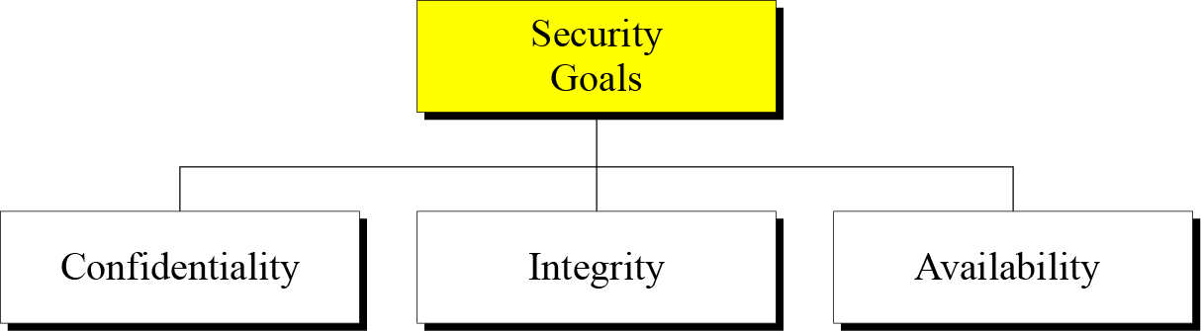
1.1 Continued
Figure 1.1 Taxonomy of security goals

Slide 5
1.1.1 Confidentiality
Most common aspect of information security.
To protect our confidential information
**Applies to storage and transmission of information
Eg.
In military, concealment of sensitive information
In industry, hiding data from customers
In banking, customer’s data

Slide 6
1.1.2 Integrity
Changes need to be done only by
Authorized entities &through authorized mechanisms.
Eg. Banking-when customer deposit and withdraws money-> account information changes
Integrity violation may not necessarily through malicious act. It may be due to interruption in system due to power fluctuationsl

Slide 7
1.1.3 Availability
The information needs to be available to authorized entities.
Information needs to be constantly changed but must be accessible to authorized entities.
Eg.
Imagine what would happen to a bank if customers could not access their accounts for transactions

Slide 8
1-2 ATTACKS
Cryptographic Attacks
Cryptanalytic Attacks
Attacks are combination of statistical and algebraic techniques.
Inspects mathematical properties of the cryptographic algorithms.
Non-Cryptanalytic Attacks
Does not exploit mathematical weakness of the cryptographic algorithm

Slide 9
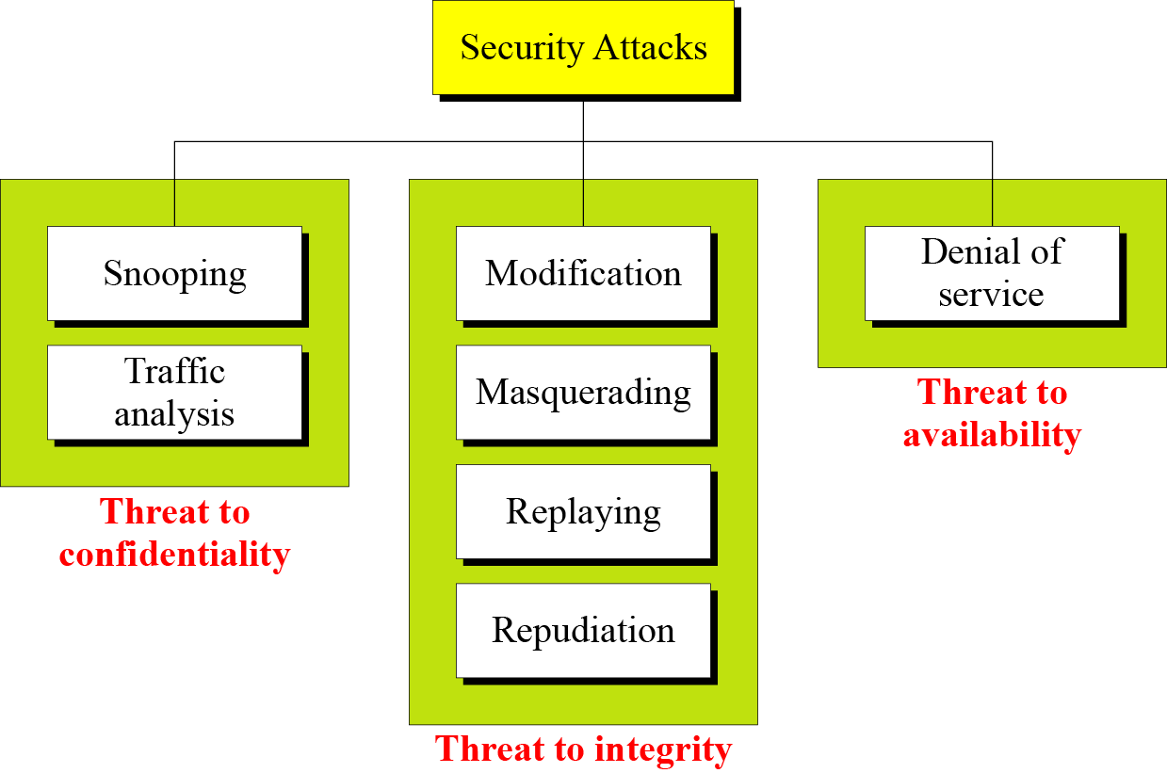
1.2 Continued
Figure 1.2 Taxonomy of attacks with relation to security goals

Slide 10
1.2.1 Attacks Threatening Confidentiality
Snooping refers to unauthorized access to or interception of data.
To prevent snooping-> encipherment techniques
Traffic analysis refers to obtaining some other type of information by monitoring online encrypted traffic.
Although encipherment makes it non-intelligible
e.g. email address of sender and receiver
To guess nature of transaction etc

Slide 11
1.2.2 Attacks Threatening Integrity
Modification means that the attacker intercepts the message and changes it. Customer send info to bank to do some transaction and attackers intercepts and changes that message.
Masquerading or spoofing happens when the attacker impersonates somebody else.
Might steal card details and pin and pretend as a customer or user contact a bank and other side pretends that it is a bank.
Replaying means the attacker obtains a copy of a message sent by a user and later tries to replay it. To receive another payment
Repudiation means that sender of the message might later deny that she has sent the message; the receiver of the message might later deny that he has received the message.
Online payment on an e-commerce site

Slide 12
1.2.3 Attacks Threatening Availability
Denial of service (DoS) is a very common attack. It may slow down or totally interrupt the service of a system.
Send so many bogus request-> server crashes
Delete a server response to client

Slide 13
1.2.4 Passive Versus Active Attacks
Passive – Goal is to obtain information. No intention to harm or modify data of a user
Active - May change data or harm the system. Easier to detect.

Slide 14
1-3 SERVICES AND MECHANISMS
ITU-T provides some security services and some mechanisms to implement those services.
Security services and mechanisms are closely related
A mechanism or combination of mechanisms are used to provide a service.

Slide 15
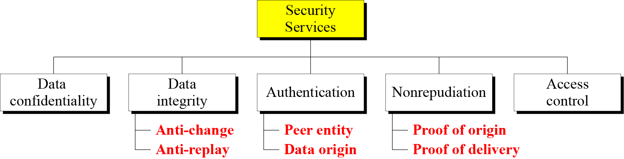
1.3.1 Security Services
Prevent disclosure
Attack
Prevent modification
Insertion
Deletion
Replaying
Conn-oriented- authenticates sender and receiver
Conn-less- authenticates source of the data

Slide 16
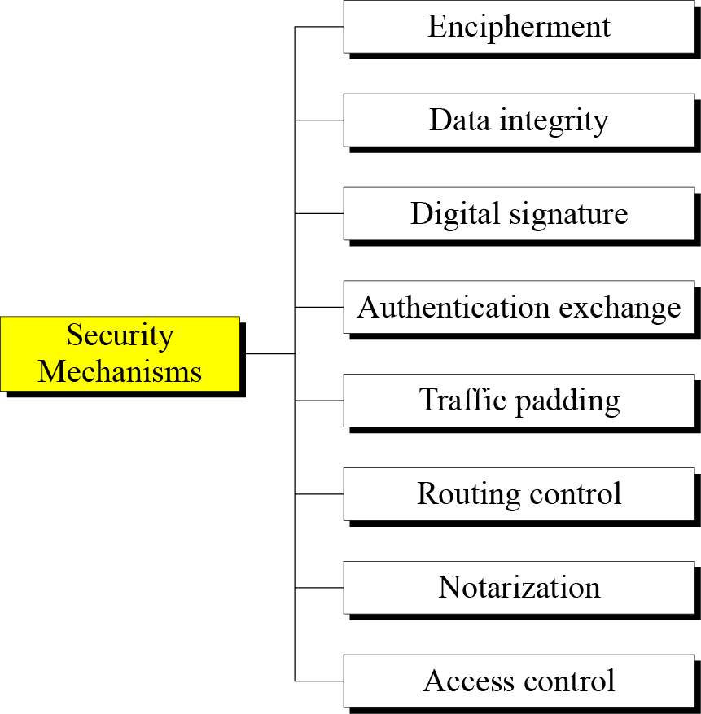
1.3.2 Security Mechanism
Figure 1.4 Security mechanisms
Hiding: cryptography or steganography
Sender Creates a Check value (using data) and send it with data. Receiver computes new check value and check it against sender’s check value.
Sender’s sign and receiver verify. Sender uses (private, public key) to sign a doc and receiver uses sender’s public key to verify.
Exchange secret to prove identity. Share secret words to authenticate
Insert bogus data to hide pattern
Continuously changing the routes
Third trusted party to control communication. Avoids repudiation attack
Proof of access e.g. pin or passwords

Slide 17
1.3.3 Relation between Services and Mechanisms

Slide 18
1-4 TECHNIQUES
Mechanisms discussed in the previous sections are only theoretical recipes to implement security.
The actual implementation of security goals needs some techniques.
Two techniques are prevalent today:
cryptography and
steganography.

Slide 19
Types of Secret Writing
Secret writing
Steganography
Cryptography

Slide 20
1.4.1 Cryptography
Cryptography, a word with Greek origins, means “secret writing.”
The science and art of transforming messages to make them secure and immune to attacks.
In past, cryptography is
Encryption + Decryption
Today, 3 different mechanisms:
Symmetric key encipherment (secret key)
Asymmetric key encipherment (public key)
Hashing (for checkvalues)

Slide 21





Model of Symmetric/Private key Cryptosystems
Same Key shared by sender and recipient
Transmitted Ciphertext
Plaintext input
Encryption Algorithm
Decryption Algorithm (reverse of encryption algorithm)
Plaintext output

Slide 22
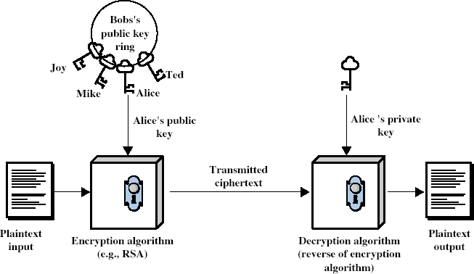
Asymmetric Key/ Public-Key Cryptography

Slide 23

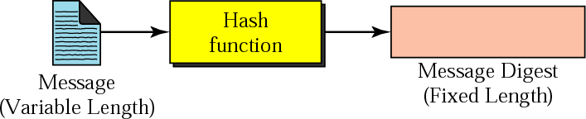

Most common hash functions are MD5 and SHA-1

Slide 24
Steganography
Steganography is the technique of hiding confidential information within any media.
Steganography is often confused with cryptography because the two are similar in the way that they both are used to protect confidential information. The difference between the two is in the appearance in the processed output; the output of steganography operation is not apparently visible but in cryptography the output is scrambled so that it can draw attention.
Steganalysis is process to detect of presence of steganography.
Image cover
Secret data can also be covered under a image
Audio & Video cover

